Slide 1

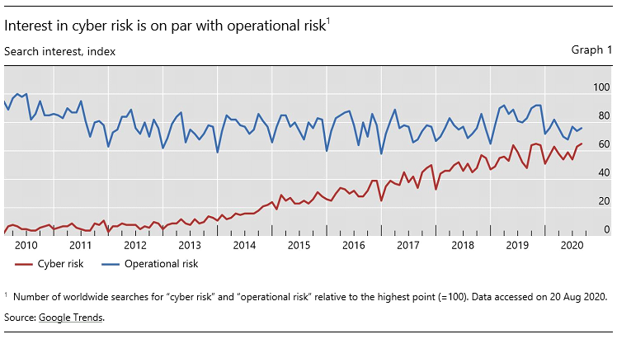
Performance modeling view
Model Validator
UUML
Collaboration & activity diagram
Performance
SRN model
Performability
SRN model
Deployment
phase
Service specification
Performability
evaluation
Model
Annotation
phase
Model
Transformation
phase
Model
Synchronization
using Guard
functions
Phase for sale
machine
generation
Dependability
SRN model
Model Validator
Dependability modeling view

